Slide 1

Southern Careers Institue powered by WOZ
Final Project – Momentum 2
Presented By
William R. Carter Jr

Slide 2
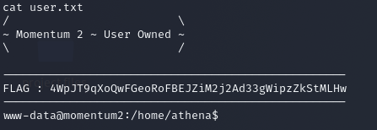
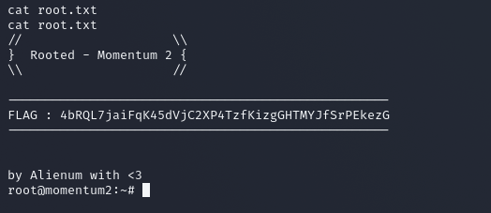
This is my final presentation. I selected the Momentum 2 from VULHUB and have collected both flags, that hidden within the virtual machine.
The virtual machine present plenty of challenges for me to overcome. These challenges presented me with an opportunity learn a large number new skills and new applications within the Kali virtual VM.
This has led me to explorer more of the tools that are integrated into the Kali platform and explorer the full functionality of each of the tool sets within Kali

Slide 3
Commands: Options explained
Netdiscover – netdiscover –r 10.0.2.0/24
Netdiscover is defined as a active/passive ARP reconnaissance tool, initially developed to gain information about wireless networks without DHCP servers in wardriving scenarios. (Debian.org)
The – r means that you are looking at a range of Ip's by sub-netmask
Nmap – nmap –v –sT –O 10.0.2.254
Nmap ("Network Mapper") is a free and open source (license) utility for network discovery and security auditing. Many systems and network administrators also find it useful for tasks such as network inventory, managing service upgrade schedules, and monitoring host or service uptime. Nmap uses raw IP packets in novel ways to determine what hosts are available on the network, what services (application name and version) those hosts are offering, what operating systems (and OS versions) they are running, what type of packet filters/firewalls are in use, and dozens of other characteristics. It was designed to rapidly scan large networks, but works fine against single hosts. Nmap runs on all major computer operating systems, and official binary packages are available for Linux, Windows, and Mac OS X. In addition to the classic command-line Nmap executable, the Nmap suite includes an advanced GUI and results viewer (Zenmap), a flexible data transfer, redirection, and debugging tool (Ncat), a utility for comparing scan results (Ndiff), and a packet generation and response analysis tool (Nping).
The – v means verbose
The – sT means --sS/sT/sA/sW/sM: TCP SYN/Connect()/ACK/Window/Maimon scans
The –O when enabled detects OS detection

Slide 4
Gobuster
gobuster dir -u http://10.0.2.251/ -w /usr/share/wordlists/dirbuster/directory-list-2.3-medium.txt -x html,php,bak,txt,php.bak
Gobuster is a tool used to brute-force:
URIs (directories and files) in web sites.
DNS subdomains (with wildcard support).
Virtual Host names on target web servers.
Open Amazon S3 buckets
The –u means the url or the location of the url you are running it against
The –w means the path to the worklist that using to do the brute force
The –x is the type of files that you are processing
Netcat
Netcat is a command line tool responsible for reading and writing data in the network. To exchange data, Netcat uses the network protocols TCP/IP and UDP. The tool originally comes from the world of Unix but is now available for all platforms.Due to its universal usability, it often called the “Swiss army knife for TCP/IP”.
The –l option puts netcat in the ‘listener’ mode
The -n option tells netcat to work in numeric no DNS
The –v option puts netcat in verbose or Extensive output mode
The –p option tells netcat what port to connect too or listen on passed on the other options specified

Slide 5
Rlwrap
rlwrap is a 'readline wrapper', a small utility that uses the GNU Readline library to allow the editing of keyboard input for any command.
Export TERM=xterm
TERM sets the terminal emulator to Linux. Depending on the environment and capability you’re using, some emulations will work better than others.

Slide 6
Sources:
Export TERM=xterm (or Linux)
https://askubuntu.com/questions/920908/what-does-export-term-linux-actually-do-when-inside-a-script#:~:text=The%20export%20TERM%3Dlinux%20command%20sets%20the%20terminal%20emulator,check%20your%20TERM%20setting%20by%20running%20echo%20%24TERM.
Gobuster:
https://www.kali.org/tools/gobuster/
NetDiscover:
https://github.com/CyCoreSystems/netdiscover
Netmap:
http://info.iet.unipi.it/~luigi/netmap/
Nmap:
https://nmap.org/
Rlwrap:
https://github.com/hanslub42/rlwrap

Slide 7
Personal Contact and resource:
Bill Bowman
Shaun Manzano
Student Contacts:
Dominic Polizzi
Ed Appling
Luna Winchester
Mike Ford
William R. Carter Jr.

